Slide 1

Sustainable Crop Yield Prediction via Multi-modal AI
Robustness under Modality Degradation
MSc Dissertation Project Presentation
Student ID - 202441750 MSc Artificial Intelligence, University of Hull

Slide 2
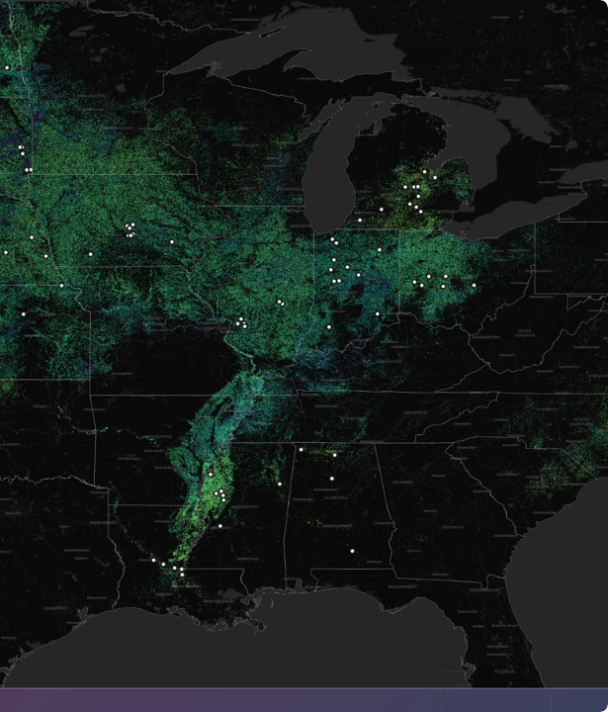
Context & Problem
Reliance on Earth Observation
Modern Agricultural AI depends on multimodal Earth Observation data to forecast yields. This typically includes meteorological tensors and optical satellite imagery.
However, the real-world operational environment is volatile. Optical sensors are notoriously susceptible to noise, creating a profound gap between theoretical model accuracy and operational reliability.

Slide 3



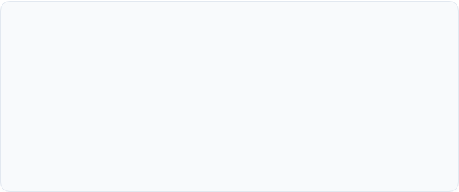

Why This Matters
Global Food Security
Climate Adaptation
Predicting harvests ensures stable food supply chains in an increasingly volatile world, preventing regional shortages.
Responding intelligently to unprecedented environmental volatility and extreme weather events.
Agricultural Sustainability
Macroeconomic Planning
Optimizing precise resource allocation (water, fertilizer, labor) to minimize ecological footprint.
Informing commodity markets, crop insurance underwriting, and proactive government policy.

Slide 4

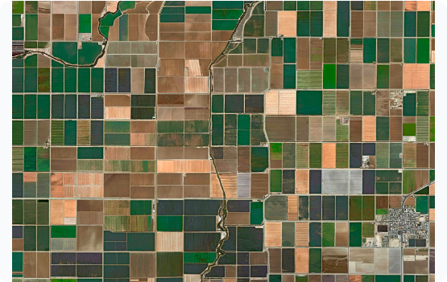
The Challenge: Modality Degradation
•
Optical Satellites (Sentinel-2): Frequently obstructed by dense cloud cover or atmospheric scattering, rendering spatial matrices useless.
•
Meteorological Models (HRRR): Provide continuous temporal data but lack the fine spatial granularity to capture localized crop stress.
•
Standard Fusion Failure: Traditional Deep Learning models process modalities rigidly. When forced to digest noise from clouded imagery, predictions collapse catastrophically.

Slide 5


Options Considered & Selected Approach
1. Rejected Baselines
2. Selected: Gated Multimodal Unit
Unimodal Models: Using only CNNs for images or LSTMs for weather ignores vital contextual synergies.
The Solution: I developed a GMU architecture that utilizes deep feature-level fusion.
Static Fusion (Early/Late): Early concatenation forces the network to learn unified representations from disparate temporal resolutions. Late α-blending statically averages outputs, failing instantly if one stream (e.g., satellite) outputs garbage data due to clouds.
Why? It calculates dense mathematical attention weights (a gate) to evaluate the reliability of each input stream. If satellite data is corrupted, the gate dynamically reroutes predictive logic to rely solely on the uncorrupted weather data.

Slide 6






Data Preprocessing & Infrastructure
The CropNet Dataset
The FIPS Bottleneck
Target Transformation
Discovered a profound infrastructural mismatch between Sentinel (County ANSI) and USDA data, reducing usable multimodal data to ~14 state-years via state-aggregate fusion.
Targeting USDA NASS Soybean Yield (BU/ACRE). Utilizing HRRR Meteorological Tensors and Sentinel-2 Multispectral Imagery across the US Corn Belt (2016-2022).
Raw yields exhibited extreme non-normality. Applied log-transformation for SGD stability, requiring Jensen's Bias Correction during inference.

Slide 7
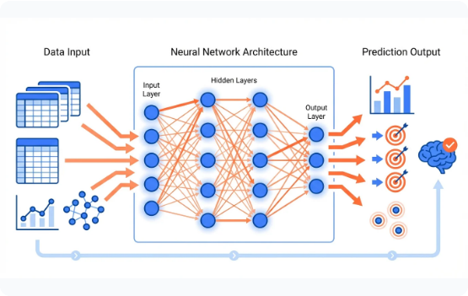

What Was Developed: GMU Architecture
I engineered a dual-stream neural network replacing static averaging with adaptive mathematical gating.
•
Encoders: Weather via Bi-LSTM; Satellite via CNN
.
•
Gate : Dynamically routes predictions based on input reliability.

Slide 8






System Architecture: 3 Training Phases
Phase 1: Weather-Only Bi-LSTM
Phase 2: Satellite-Only CNN
Phase 3: GMU Fusion
•
2-layer bidirectional LSTM (hidden=128)
•
Custom SentinelEncoder (12→32→64 ch)
•
Combines Phase 1 + Phase 2 outputs
•
~146K parameters
•
~59K parameters
•
Gate dynamically weighs inputs
•
Trained on 2,828 records (15 states)
•
Two-phase training: A (frozen) → B (end-to-end)
•
Trained on 14 state-years (FIPS limited)
•
Output: temporal weather embedding
•
~255K total parameters
•
Output: spatial visual embedding

Slide 9
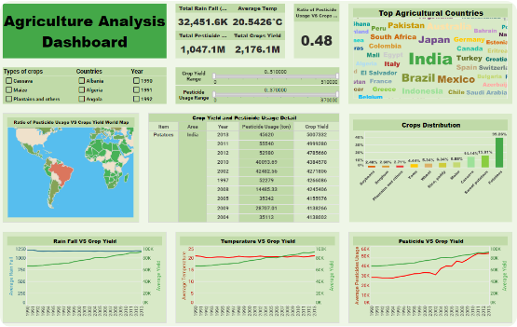
Software Solution & Implementation
The solution was implemented as a modular, scalable software notebook that can be converted to pipeline, ensuring reproducibility and readiness for operational agricultural dashboards.
•
Framework: Built on PyTorch Lightning to decouple the complex multimodal research code from standard training loops.
•
Data Loaders: Custom ingestion engines to handle disparate shapes (1D weather time-series vs 3D spatial sequences).
•
Inference Pipeline: Automated inverse log-transformations using Jensen's inequality to yield human-readable BU/ACRE metrics.

Slide 10
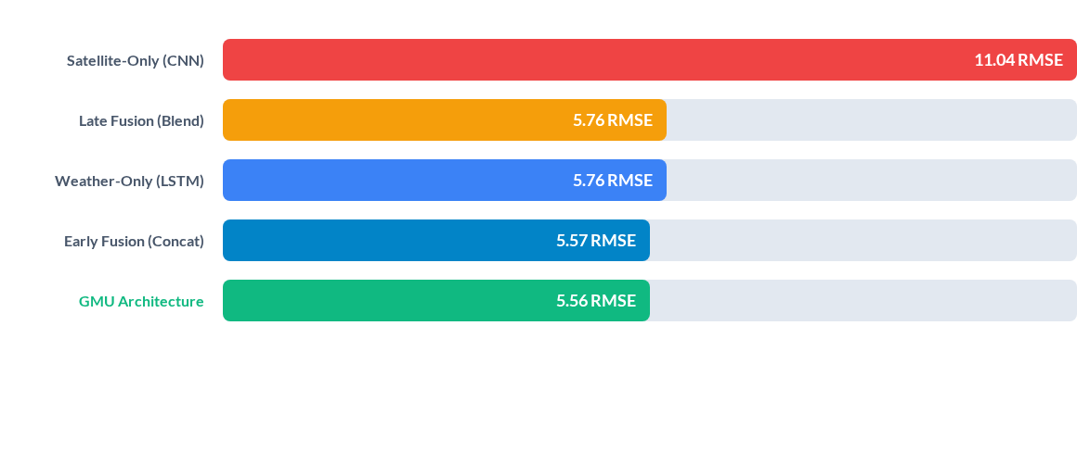
Results: Baseline vs. Fusion Models
Evaluation on LOSO 2022 state-aggregate holdout. The GMU achieved the lowest RMSE. Notably, Late Fusion collapsed entirely to the Weather-only baseline, proving it cannot recover from weak optical encoders.

Slide 11
Discussion: Resilience Under Stress
The models were subjected to simulated sensor failures. A key finding was the autonomous adjustment of the GMU's gate ( ).
Modality Status | Gate (z) Value | RMSE (BU/ACRE) | System Response
Normal (Full Modality) | 0.575 | 5.08 | Balanced multimodal feature extraction.
Weather Dropout | 0.576 | 12.29 | Routes towards Satellite; degrades due to spatial noise.
Satellite Dropout (Clouded) | 0.621 | Out of Distribution | Gate attempts routing to Weather, but extreme OOD embeddings cause failure.
*Complete satellite removal produced extreme OOD embeddings, indicating a need for a binary availability safeguard at deployment.

Slide 12


Discussion: Interpretability & Fairness
SHAP Validation (XAI)
Geographic Bias Audit
Extracted feature importance confirmed the network prioritized critical biological drivers like Vapor Pressure Deficit and Max Temperature in mid-summer.
The model hyper-optimized for the Corn Belt due to data density. The Max/min RMSE ratio across states was a concerning 32.95x.
This validates that the deep learning model is mapping to actual agronomic realities, rather than memorizing noise.
This indicates that marginal farming states suffered higher errors, mandating equity-weighted loss functions for future iterations.

Slide 13


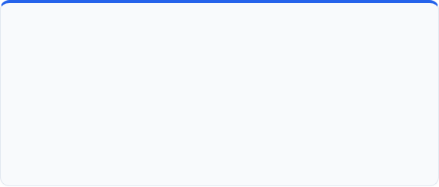

Key Findings
1. Gating Helps, But Isn't Magic
2. Late Fusion is Flawed
•
GMU modestly outperforms weather-only (5.562 vs 5.763).
•
Optimizer assigned α=1.00 (100% weather) in Late Fusion.
•
Satellite encoder was TOO WEAK to provide meaningful correction.
•
Decision-level fusion cannot recover from weak encoders.
•
Limited by ~14 state-years of training data.
•
Embedding-level fusion is minimum viable strategy.
3. Data Infrastructure Barrier
4. Geographic Bias is Severe
•
FIPS misalignment limited multimodal training.
•
32.95× RMSE ratio between best and worst states.
•
This is a DATA ENGINEERING problem, not an algorithmic one.
•
Poses a significant ethical concern for deployment in marginalized regions.

Slide 14
Conclusions & Recommendations
Algorithmic Superiority: Deep feature-level fusion with adaptive gating out-performs naive static fusion, providing crucial resilience against non-stationary agricultural noise.
Infrastructure Bottleneck: The FIPS alignment gap between Sentinel and USDA databases is the primary barrier to continental-scale deployment, overshadowing algorithmic constraints.
Deployment Safeguards: Our software demonstration proved that real-world deployment requires strict boundary checks to prevent cascading Out-of-Distribution failures during severe cloud cover.
Ethical AI Required: Geographic cross-validation error weighting is imperative to prevent systemic disenfranchisement of marginal farming regions in future agricultural AI tools.

Slide 15
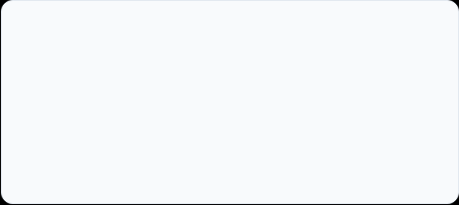
Thank You!
Dipanjan Das (202441750)
MSc Artificial Intelligence | University of Hull
D.DAS7-2023@hull.ac.uk

